Slide 1
RISK ASSESSMENT OF LOAN APPLICATIONS

Slide 2
Abstract
Some consumer Finance Company wants to understand the factors that drives a consumer to default a loan rather than paying.
Given the understanding of these factors, company can reduce the risk of issuing loan to a consumer who may default.
We've performed a thorough analysis on the available data and have categorized factors to be either customer attributes or loan attributes.
Below are the choosen factors that impacts the possibility of defaulting a loan:
Customer Attributes: Home Ownership, Bankrupties Record, Credit Inquiry in Last 6 Months, Purpose of Application
Loan Attributes: Loan Amount, Interest Rate, Loan Term, Loan Grade
This presentation explains the analysis performed on above factors.
Based on this analysis, we will be able to recommend when a loan is unsafe to issue.
The Objective is to identify these risky loan applicants, then such loans can be reduced thereby cutting down the amount of credit loss.

Slide 3
Approach
Data Understanding and cleaning
Univariate Analysis
Segmented Univariate Analysis
Recommendations
Bivariate Analysis

Slide 4
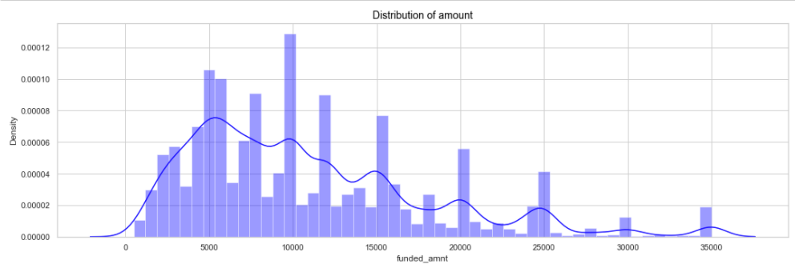
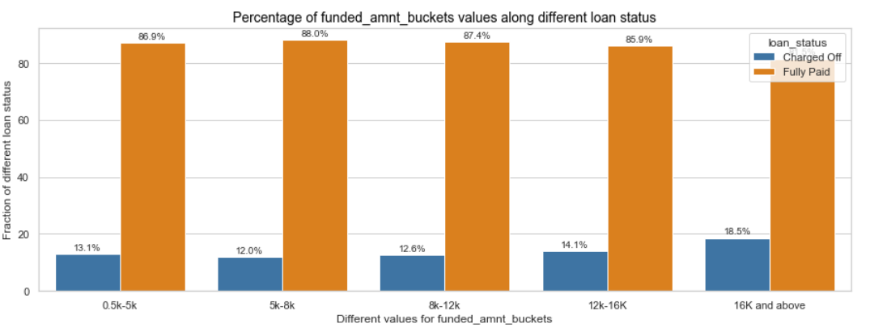
Loan Attribute - Funded Amount
Funded amount is the total amount commited to the loan by LC. This amount is co-related to loan amount that borrower requested, and to the actual amount funded by investor. For that reason, analysis on any one of these is true for all three of them.
Trend:
As seen in distribution, most of the issued loans are under $15K with a spike around $16K.
Also, around 18.5% people defaulted their loans when
funded amount was $16k or above.
Recommendation:
LC needs to perform extra checks when issuing loans higher than $16k, as default rate is much higher there.

Slide 5
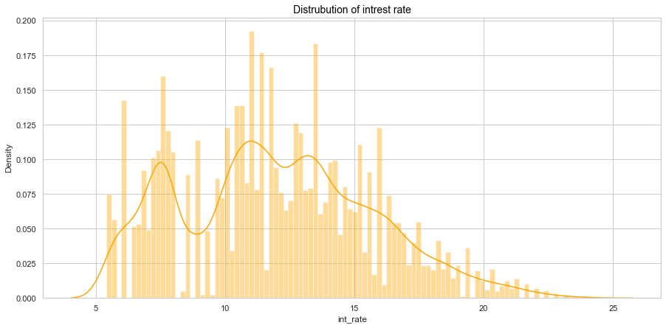
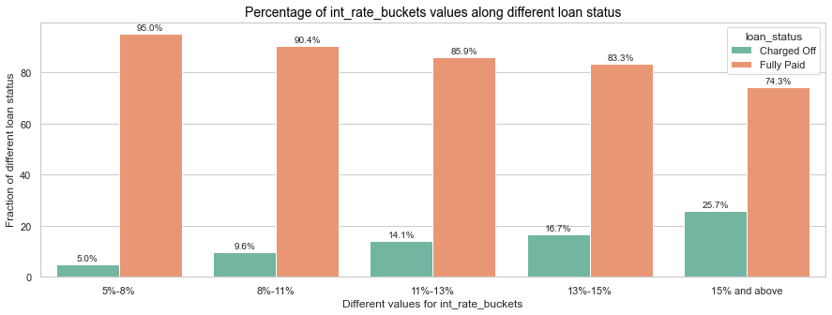
Loan Attribute - Interest Rate
Trend:
Distribution indicates that most of the issued loans are with interest rate below 15%.
Also, 25% of the borrowers defaults loan when interest rate is more than 15%.
Recommendation:
LC should avoid issuing loans at rates higher than 15%.

Slide 6
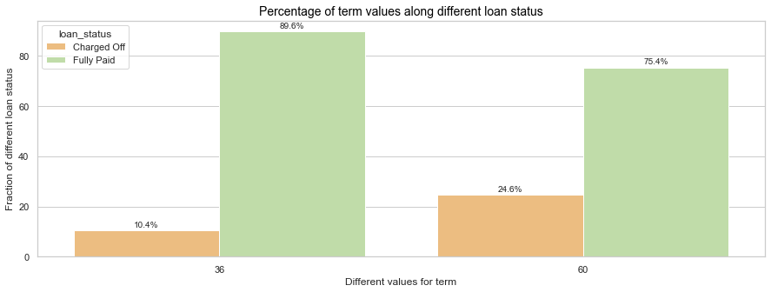
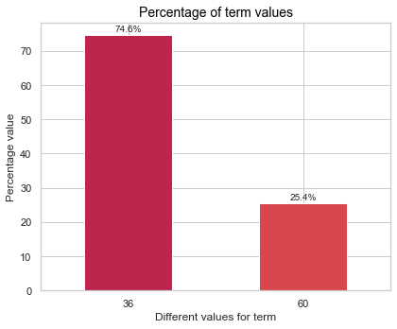
Loan Attribute - Term
Trend:
75% of the loans are issued for a term of 36 months.
25% of the borrowers defaults loan when term is 60 months.
Recommendation:
LC only issues 25% of their loans for 60 months term. There is still a need to scrutinized these 60 months term loans, as one fourth of them are defaulted. Other factors that can be considered along with term are explained later in this presentation.

Slide 7
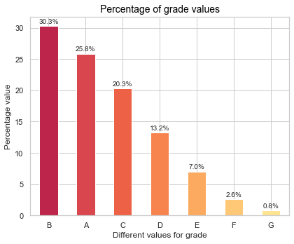
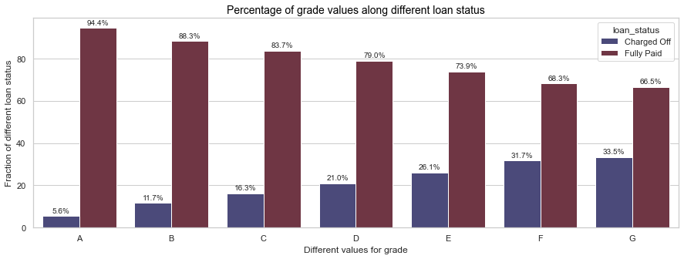
Loan Attribute - Grade
Trend:
More than 75% of the loans are issued for grades A, B or C.
Grade D or below are having higher chances (>20%) of defaulting.
Recommendation:
LC should get rid of issuing grades F and G loans, as it's less than 3% of business, with over 30% default rate.
They should also take precautionary measures while issuing a grade D and grade E loans.

Slide 8
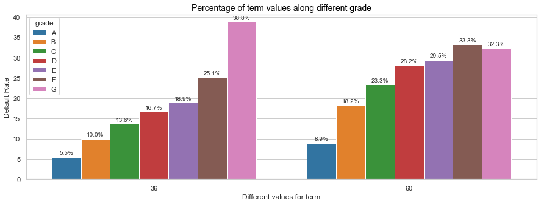
Term and Grade Relationship
Trend:
For 36 months, grades D and below averages 20% default rate
For 60 months, grades D and below averages 30% default rate
Recommendation:
As mentioned in previous slide that LC should get rid of grade F and G, and proceed with caution on grades D and E.
Chart below clarifies that LC should stop issuing grade D and E loans for 60 months term.

Slide 9
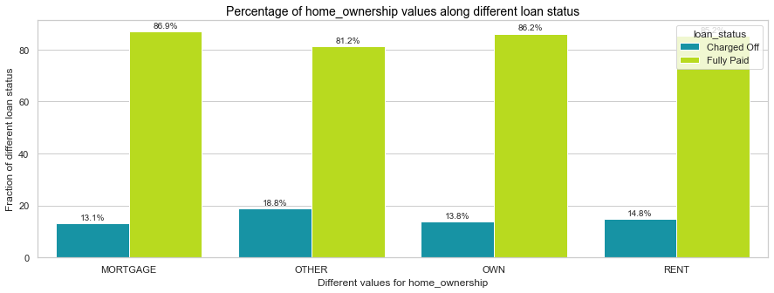
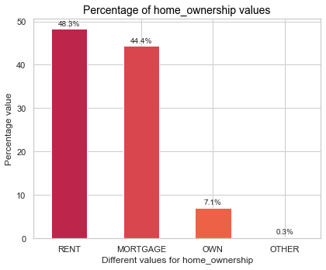
Customer Attribute - Home Ownership
Trend:
0.3% of the borrowers define their home ownership as 'OTHER'.
Default rate is almost 20%, when home ownerships is selected a 'OTHER'.
Recommendation:
LC should remove 'OTHER' option from application, as it's only 0.3% of business but with a high default rate.

Slide 10
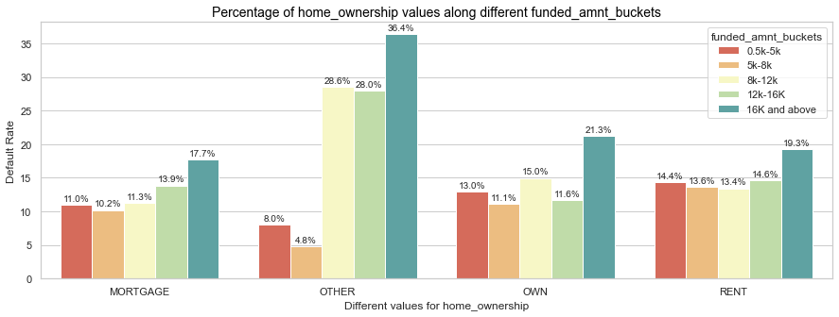
Home Ownership and Loan Amount Relationship
Trend:
In low income group , default rate goes up for borrowers who rent or own a house.
In higher income groups, default rate goes up for borrowers who define their home ownership as OTHERS
Recommendation:
Removal of OTHER option was already recommended. This chart also indicates to not issue higher amount ($16k+) loans to borrowers with own house or rentals.

Slide 11
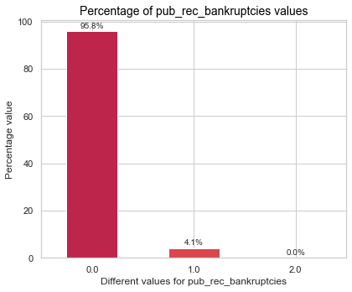
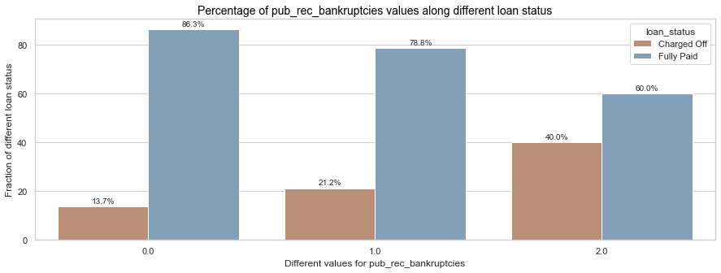
Customer Attributes - Bankruptcy Records
Trend:
Only 4% of the loans are issue to borrowers who filed for bankruptcy.
There are very high chances (>20%) of defaulting if person filed for bankruptcy.
Recommendation:
LC should only issue a loan if there are no bankruptcy records.
That's only loosing 4% of the market, but is reducing default risk by a great deal.

Slide 12
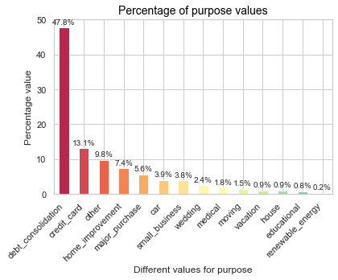
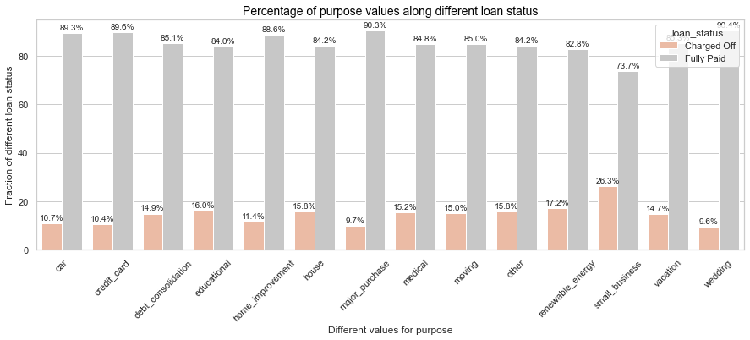
Customer Attribute - Purpose of Loan Application
Trend:
Loan Purpose 'small business','educational' and 'renewable energy' will have high chances of defaulting averaging 20%.
Recommendation:
Stop issuing loans for these purposes as it's about 2% of the business anyways, and 20% of them defaults. We have scrutinized it down in next slide.

Slide 13
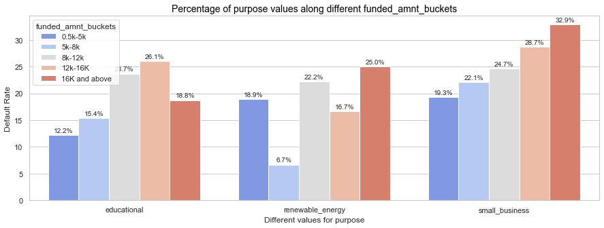
Purpose and Loan Amount Relationship
Below chart is only for the top 3 loan purposes with high default rates.
Trend:
Small Business purpose is having very high default rate for all ranges of loan amounts.
High default rate for these 3 purposes when loan amount is >$8K.
Recommendation:
Stop issuing loans for Small Business.
Stop issuing loans for Educational and Renewable Energy purposes if loan amount is >$8k.

Slide 14
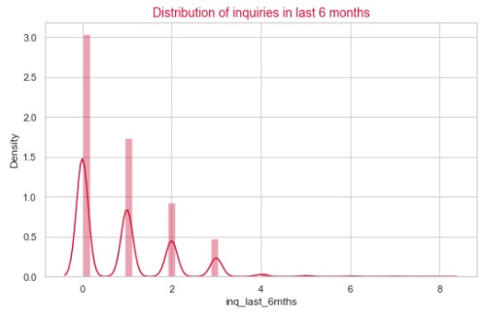
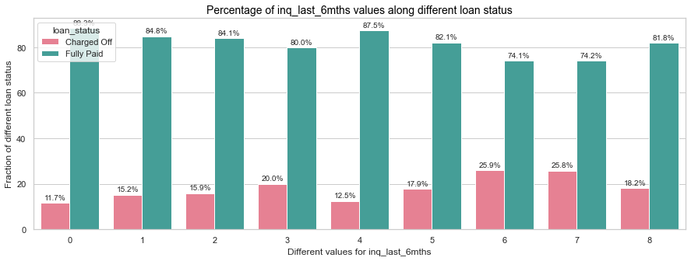
Customer Attribute - Credit Inquiry in Last 6 Months
Trend:
Most of the borrowers have 2 or less inquiries in last 6 months.
These borrowers have default rate of 15% or less.
Recommendation:
Scrutinize loans for borrowers with 3 or more inquiries in last 6 months..

Slide 15
Conclusion
Below is the summary of recommendations for LC based on data analysis explained in the presentation.
1. Do not issue a loan if there is a single bankruptcy record on borrower's public file.
2. Do not allow the option of 'Other' home ownership in the loan application.
3. Do not issue high amount loans above $16K to borrowers who own or rent a house.
4. Stop issuing loan for Small Business purpose.
5. Stop issuing higher amount loans above $8K for Educational and Renewable Energy purposes.
6. Scrutinize loans for borrowers with 3 or more inquiries in last 6 months.
7. Perform extra checks when issuing loans higher than 16k, as default rate is much higher there.
8. Avoid issuing loans at rates higher than 15%.
9. Completely stop issuing grades F and G loans.
10. Stop issuing grade D and E loans for 60 months term.

